Slide 1

PROJECT MapEat
TEAM M.A.P. -PS09
Mitali Chougule
Amey Deshingkar
Piyush Terkar

Slide 2

HACKSPRINT TEAM M.A.P.
Problem Statement : Grocery Shopping. An android application where users can purchase and order groceries online. The system is developed with a user-friendly and attractive GUI. It delivers a wide range of groceries available online. Users have to first login into the system to view the groceries and add them into their cart. The system functionality of products and orders is stored on server side in a web service. The android app is for client usage. It consists of client side scripting for placing orders by connecting to the server side web service.
Problem Statement Number : PS9
Team Name : M.A.P.
Team Leader Name : Piyush Terkar
College Name : Marathwada Mitra Mandal’s College Of Engineering

Slide 3
Idea/Approach Details
Our approach to this problem statement is such that
First we performed the server side programming in python. Which consists of User database and Product Database
Then the socket programming also in python to connect server & client.
The Graphical User Interface is done in android studio.
Language for GUI used is JAVA.

Slide 4

APPLICATION
Application are as follows:
To provide a online groceries to our customers.
Review system implemented using MACHINE LEARNING.
Powered By AI

Slide 5
Day 2 Additions
As suggested by our Mentor, we managed to individually execute our android GUI.
And later integrated it together.
Further we created the functions for each task in JAVA for each android activities.
Then we established connection between client side Android(JAVA) to server side Python program.
We designed and polished our Android GUI.
We started implementing Machine learning to server side.

Slide 6
Day 3 Additions
We made minor changes to our code to make it a little more useful.
We faced major hurdles while establishing communication part between client and server.
We solved it by defining a separate JAVA class using async task to solve the above problem.
We stabilized Machine Learning feature.
Our journey of this hacksprint was very exciting. It was a very great experience which taught us a lot of things.

Slide 7
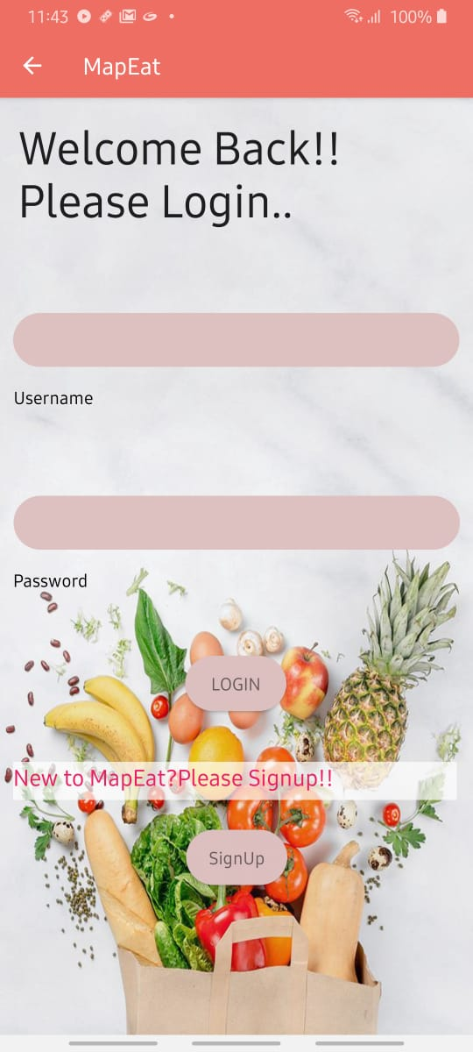
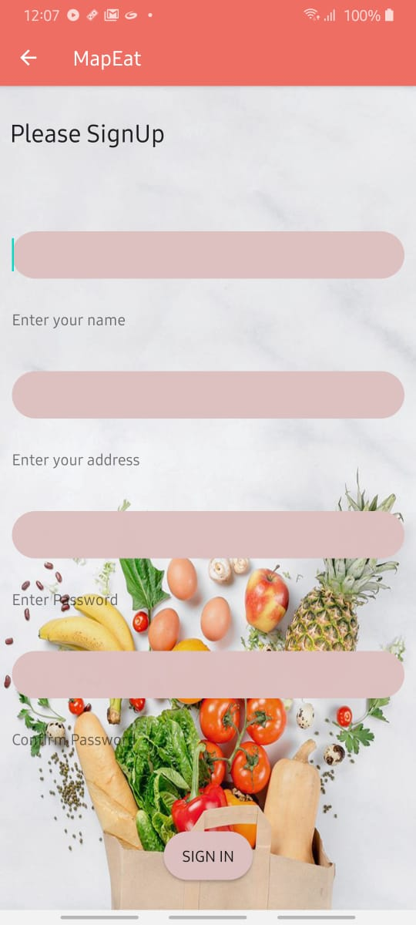
Some Screenshots of MapEat
Login screen
Sign In

Slide 8
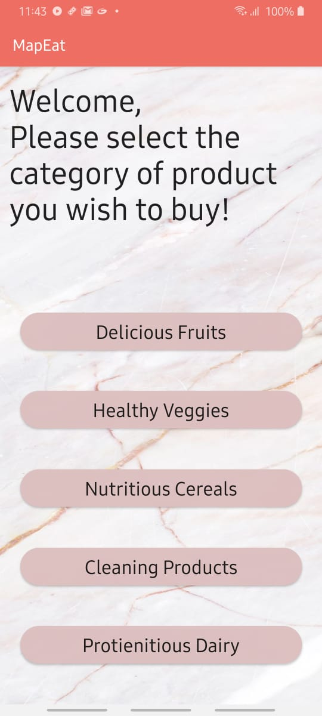
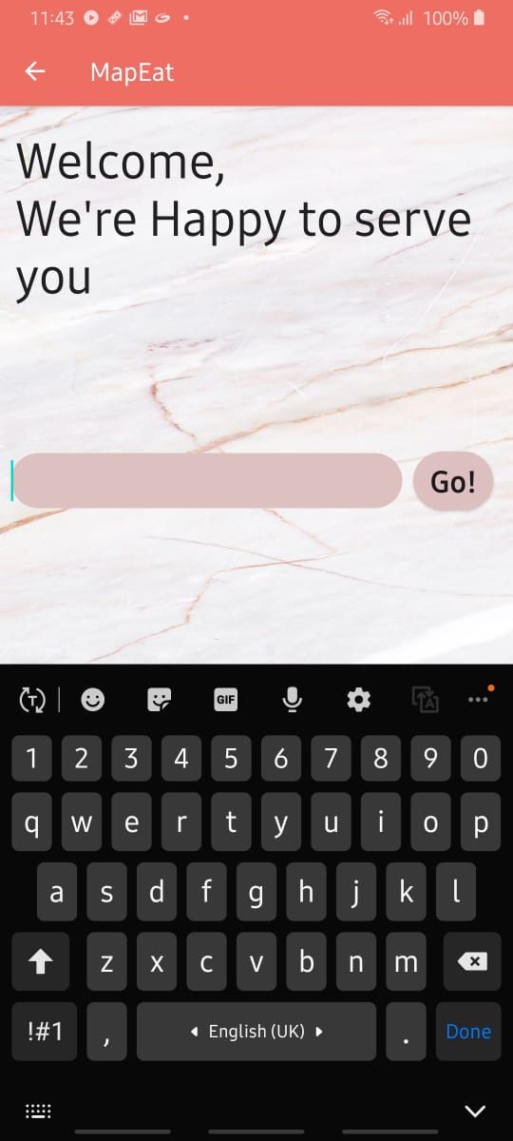
Some More!!!
Category Selection(Main activity)
Search Products

Slide 9
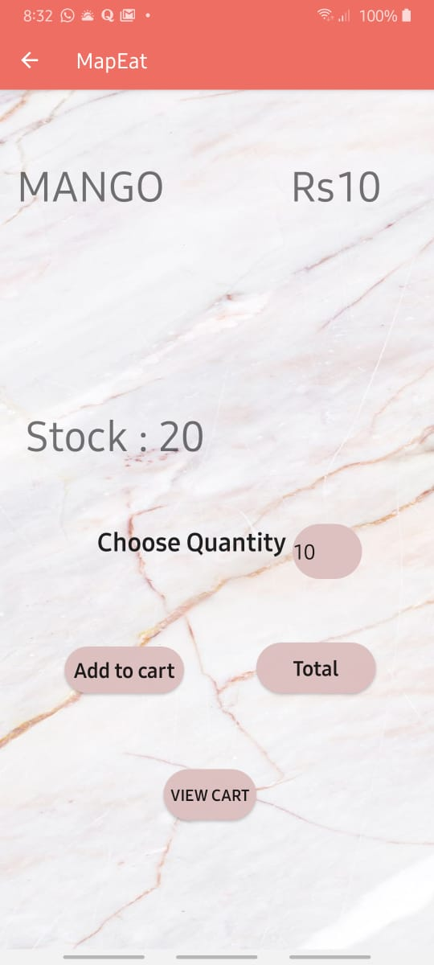
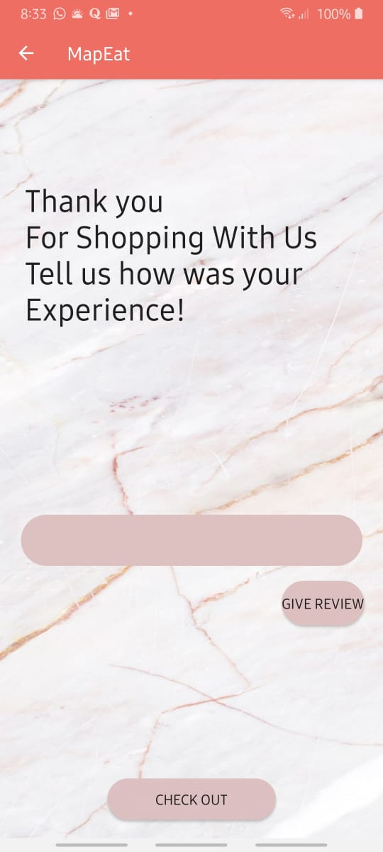
Some More
AI Based Review System.
Display Window

Slide 10
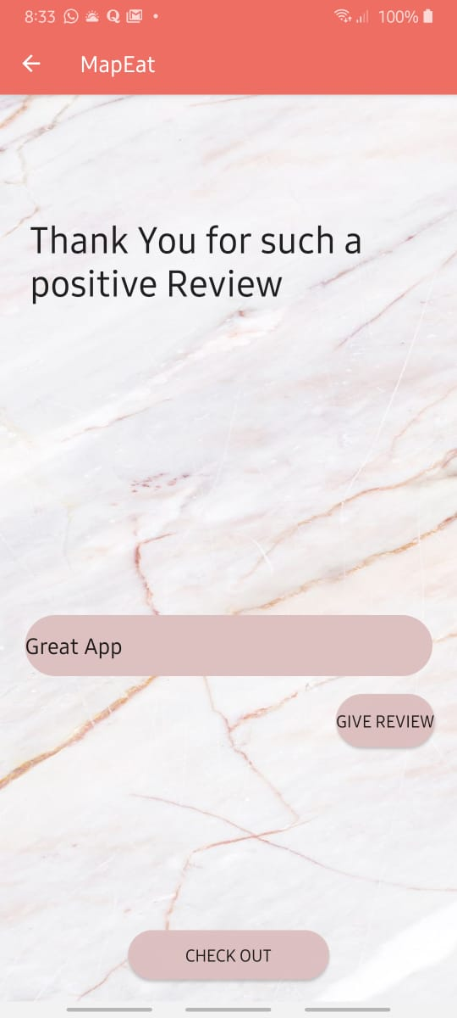
And Last
Review system implanted using Machine Learning.

